Slide 1
The Impact of Algorithms on Computing Performance Across Hardware
Bridging Algorithmic Efficiency from PCs to HPC Systems
By Matthew Fuller

Slide 2
Algorithms vs Hardware
Understanding Hardware Diversity
PC Systems: Characterized by single or multi-core processors, standard memory configurations, and storage designed for a broad range of everyday tasks. PCs are optimized for general computing needs rather than specialized computational tasks.
HPC Clusters: Comprised of multiple computing nodes with high-speed interconnects. Each node often contains multi-core or many-core processors, large amounts of memory, and sometimes accelerators like GPUs. HPC systems are engineered for parallel processing, handling complex computational problems more efficiently.
Algorithms at their Core
Algorithmic Complexity: Refers to the computational complexity of algorithms, indicating the resources needed (time and space) as a function of the input size. It plays a pivotal role in determining the performance and scalability of computational tasks.(algorithms book)
Impact on Computing Tasks: On regular PC systems, algorithms with high complexity can significantly slow down performance, even for relatively small datasets. In HPC environments, the choice of algorithm not only affects performance but also how effectively the parallel computing resources are utilized. Optimizing algorithmic efficiency can lead to substantial reductions in computation time and resource consumption.

Slide 3
Benchmarking Setup: Sorting Algorithms Across Systems
The aim of the benchmarking exercise was to assess and compare the performance of four popular sorting algorithms - Bubble Sort, Merge Sort, Selection Sort, and Quick Sort - across different computing environments.
These environments included a regular personal computer (PC), a single node on a High-Performance Computing (HPC) cluster, and a parallelized setup both the PC and HPC environment.
The four graphs are presented in the following slide, where we can see the similarities and differences between the architectures presented plus the differences associated with the sorting algorithms.
The graphs represent averages of 5 runs of the program in the specified environment .
Assume Python language unless otherwise stated.

Slide 4
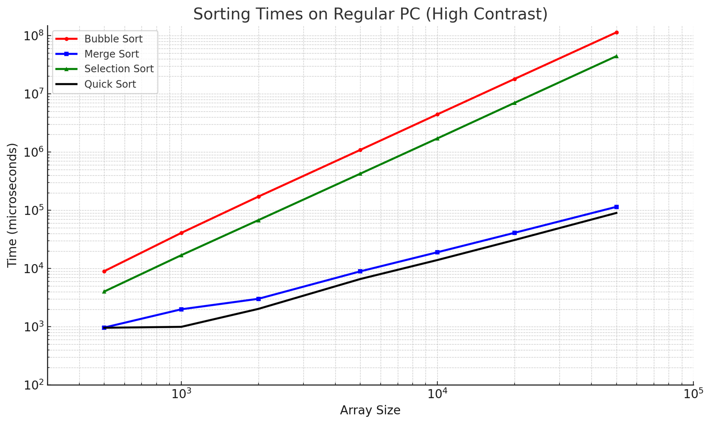
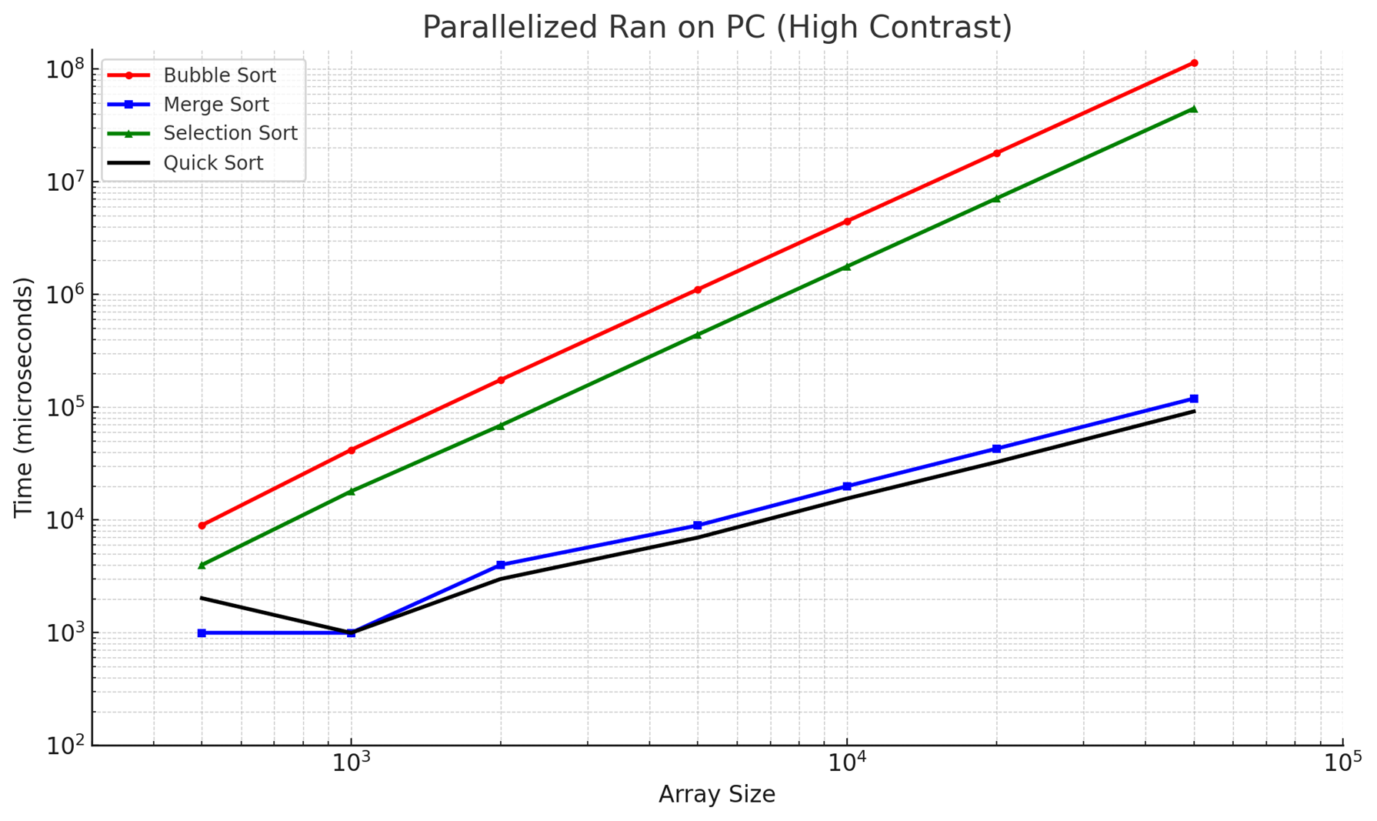
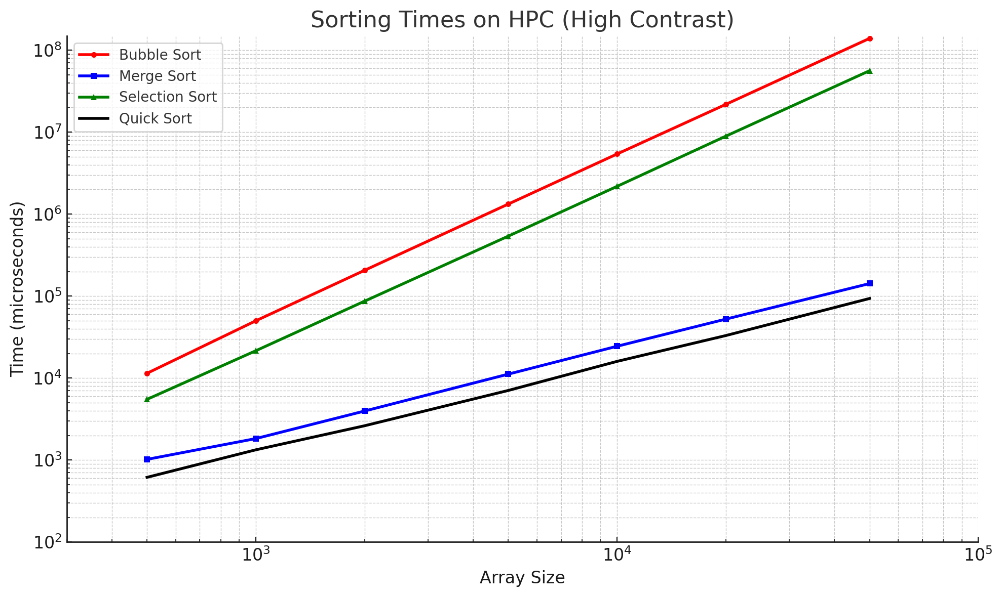
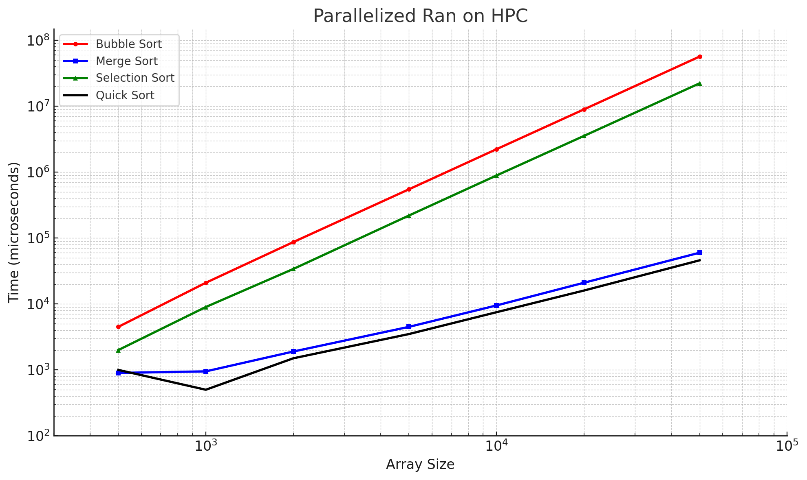

Slide 5
Approximated
Notes:
Approximated due to issues originally generating the parallelized HPC varation to this, I left it in to show the vast difference between the approximated and the actual values.

Slide 6
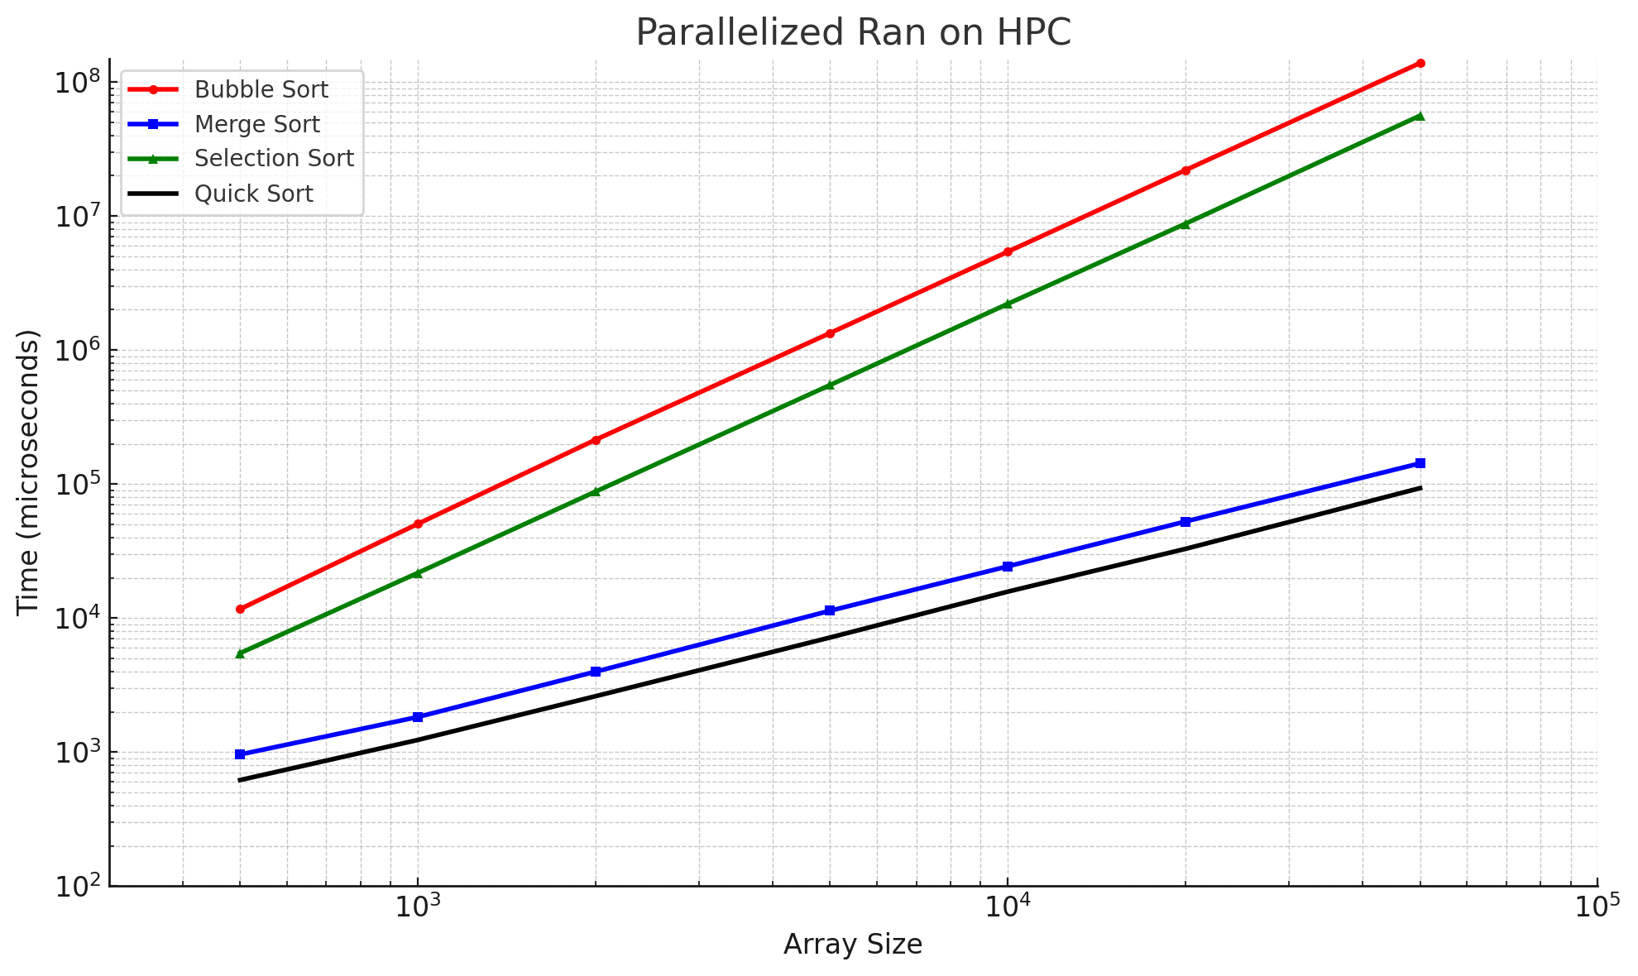
Actual
Notes:
After some interesting emails about using mpi4py on an distributed system, we got the actual averages for this hardware variation. However, there are many discrepancies and due to algorithmic constraints that cause the mpi to act strangly in a distributed environment.

Slide 7
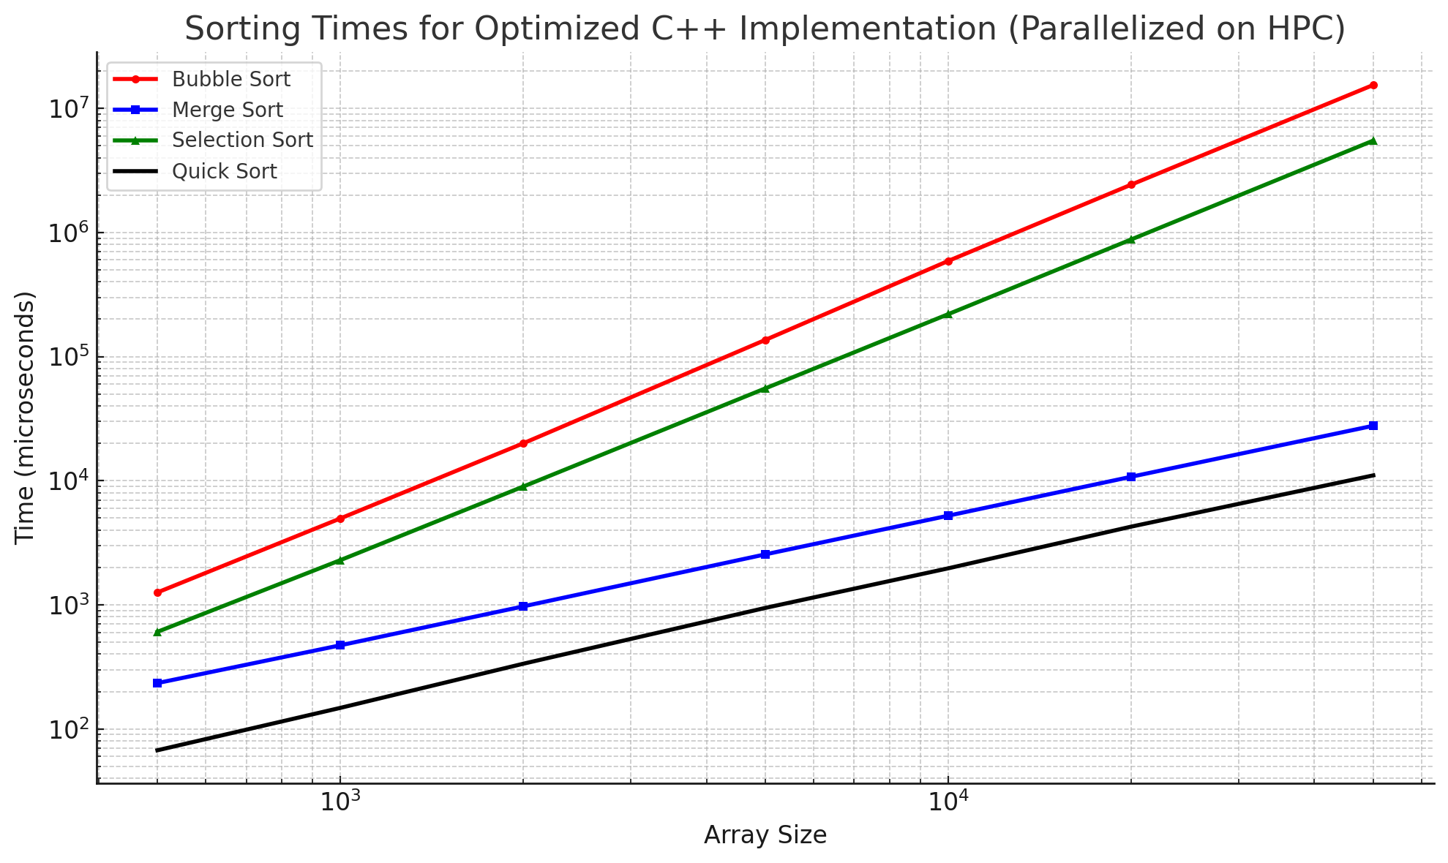
Notes:
So, we tested with a c++ implementation and wow, look a the magnitude change in running times.

Slide 8
Analysis and Evolution of Algorithmic Efficiency
Predictable Performance Trends: The observed running times of various sorting algorithms consistently align with theoretical predictions. This consistency holds true across a diverse range of hardware environments, underscoring the primary influence of algorithm design on computational efficiency.
Algorithmic Dominance: Despite the substantial hardware advancements over the years, the efficiency of computational processes remains most directly influenced by the algorithms themselves. This suggests that the choice of algorithm is a crucial determinant of performance, often overshadowing hardware capabilities.
Notes:
Merge Sort:
Average Case: O(nlog⁡n)O(nlogn)
Worst Case: O(nlog⁡n)O(nlogn)
Merge Sort is a divide-and-conquer algorithm. It divides the unsorted list into nn sublists, each containing one element (a list of one element is considered sorted), then repeatedly merges sublists to produce new sorted sublists until there is only one sublist remaining. This will be the sorted list.
Quick Sort:
Average Case: O(nlog⁡n)O(nlogn)
Worst Case: O(n2)O(n2)
However, with good pivot selection strategies, the worst-case scenario is rare. Quick Sort is also a divide-and-conquer algorithm. It picks an element as a pivot and partitions the given array around the picked pivot. There are different versions of quick sort that pick pivot in different ways, such as picking the first element as pivot, picking the last element as pivot, picking a random element as pivot, etc.
Selection Sort:
Average Case: O(n2)O(n2)
Worst Case: O(n2)O(n2)
Selection Sort is an in-place comparison sorting algorithm. It divides the input list into two parts: a sorted sublist of items which is built up from left to right at the front of the list and a sublist of the remaining unsorted items that occupy the rest of the list. Initially, the sorted sublist is empty, and the unsorted sublist is the entire input list. The algorithm proceeds by finding the smallest (or largest, depending on sorting order) element in the unsorted sublist, exchanging it with the leftmost unsorted element (putting it in sorted order), and moving the sublist boundaries one element to the right.
Bubble Sort:
Average Case: O(n2)O(n2)
Worst Case: O(n2)O(n2)
Bubble Sort is a simple sorting algorithm that repeatedly steps through the list, compares adjacent elements, and swaps them if they are in the wrong order. The pass through the list is repeated until the list is sorted. Despite its simplicity, bubble sort is highly inefficient for sorting large data volumes.

Slide 9
GITHUB repo for Project
All code can be found here:
https://github.com/Druspect/HPC-Algorithmic-Growth-Project/tree/main

Slide 10
References
Foster, Ian. Designing and Building Parallel Programs. Version 1.3, Addison-Wesley Inc. in collaboration with Argonne National Laboratory and the NSF Center for Research on Parallel Computation, 1995, dbpp@mcs.anl.gov.
Huang, Qijing. "Co-design of Algorithms, Hardware, and Scheduling for Deep Learning Applications." Electrical Engineering and Computer Sciences, University of California, Berkeley, Technical Report No. UCB/EECS-2021-202, 16 Aug. 2021, www2.eecs.berkeley.edu/Pubs/TechRpts/2021/EECS-2021-202.html.
Cormen TH, Leiserson CE, Rivest RL, Stein C. Introduction to Algorithms, Third Edition. Cambridge, MA: The MIT Press; 2009. Introduction to Algorithms, third edition - MIT Press

Slide 11
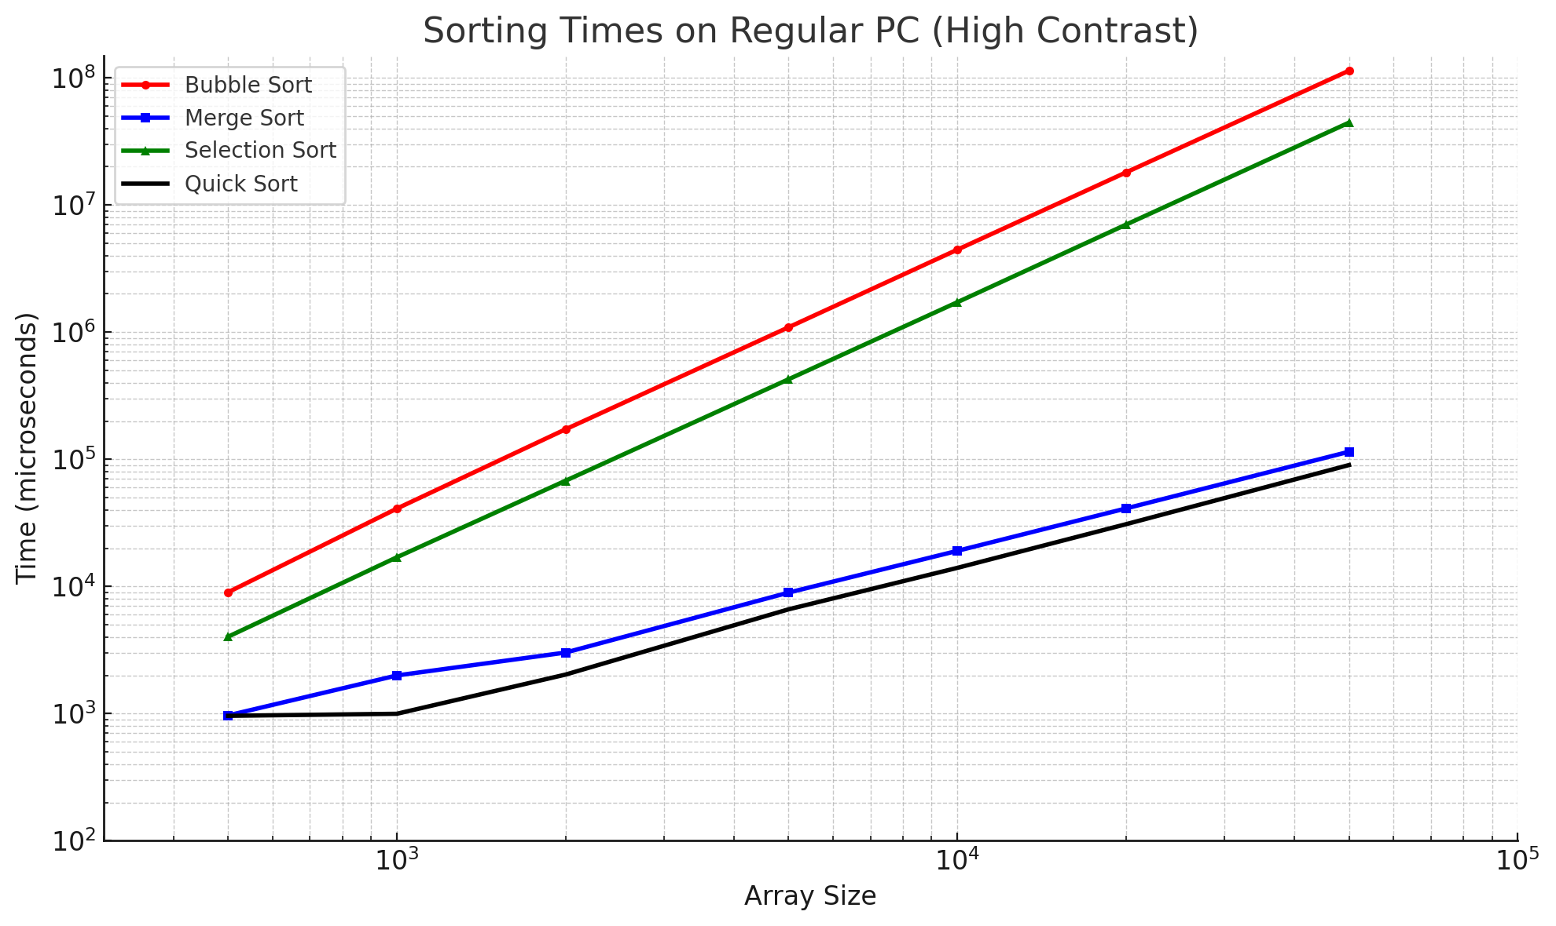
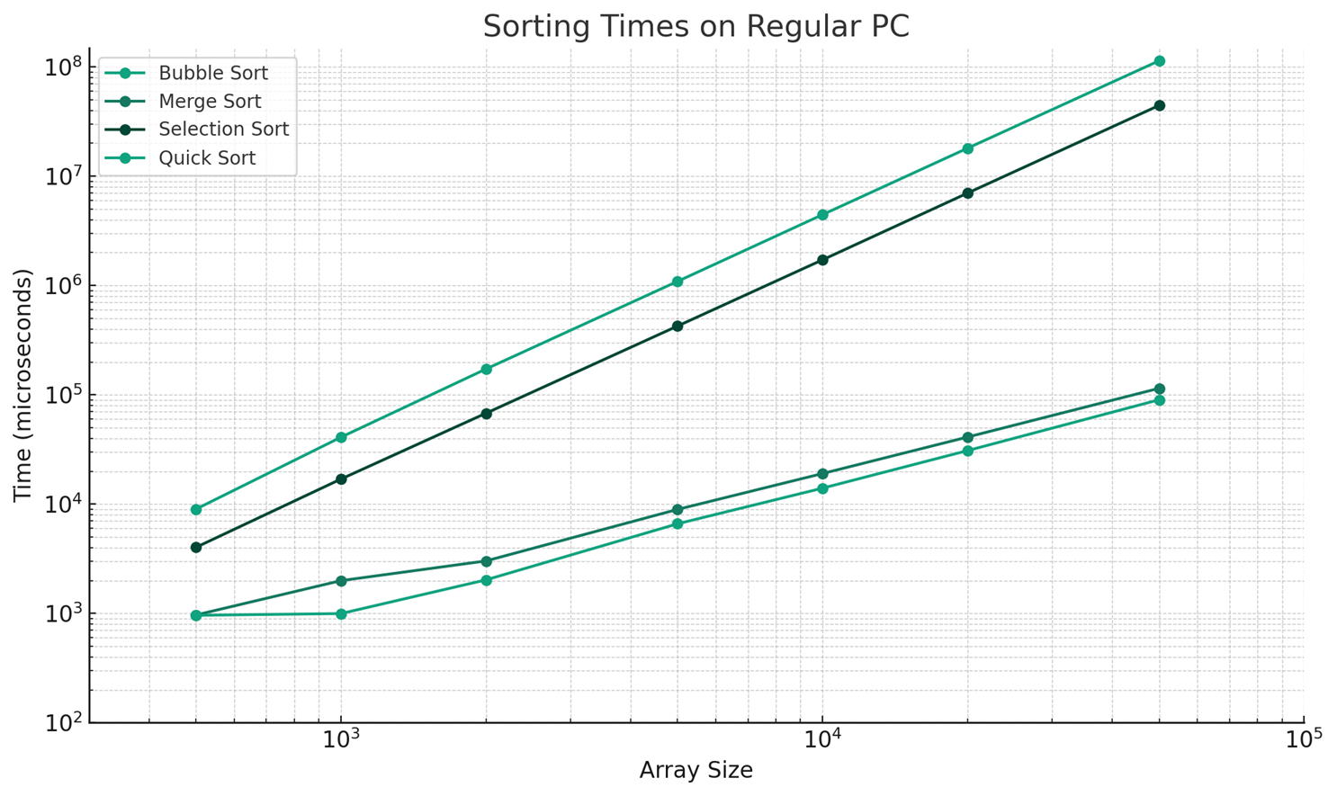

Slide 12
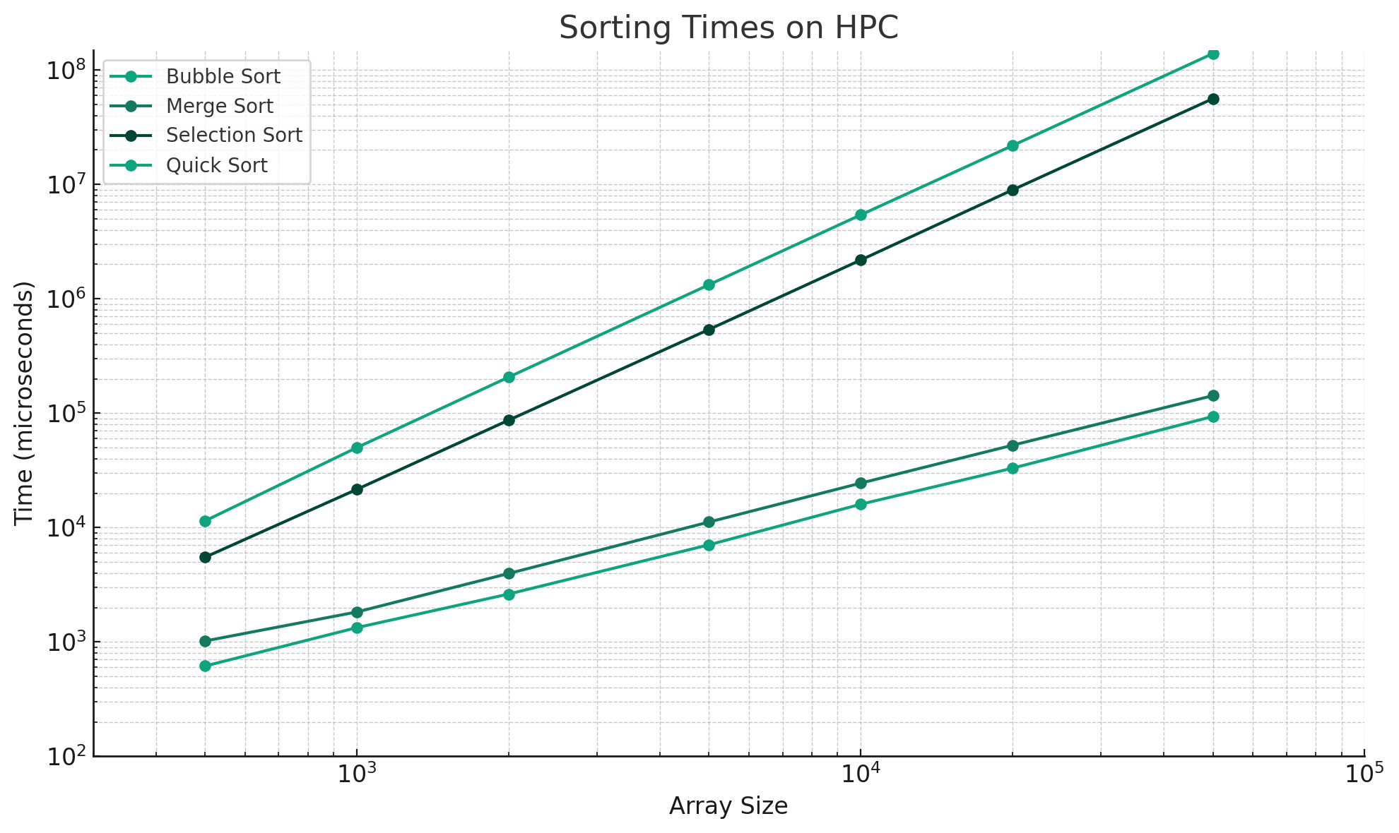

Slide 13


Slide 14
Approximated

